Slide 1
Regional Myths And Beliefs

Slide 2
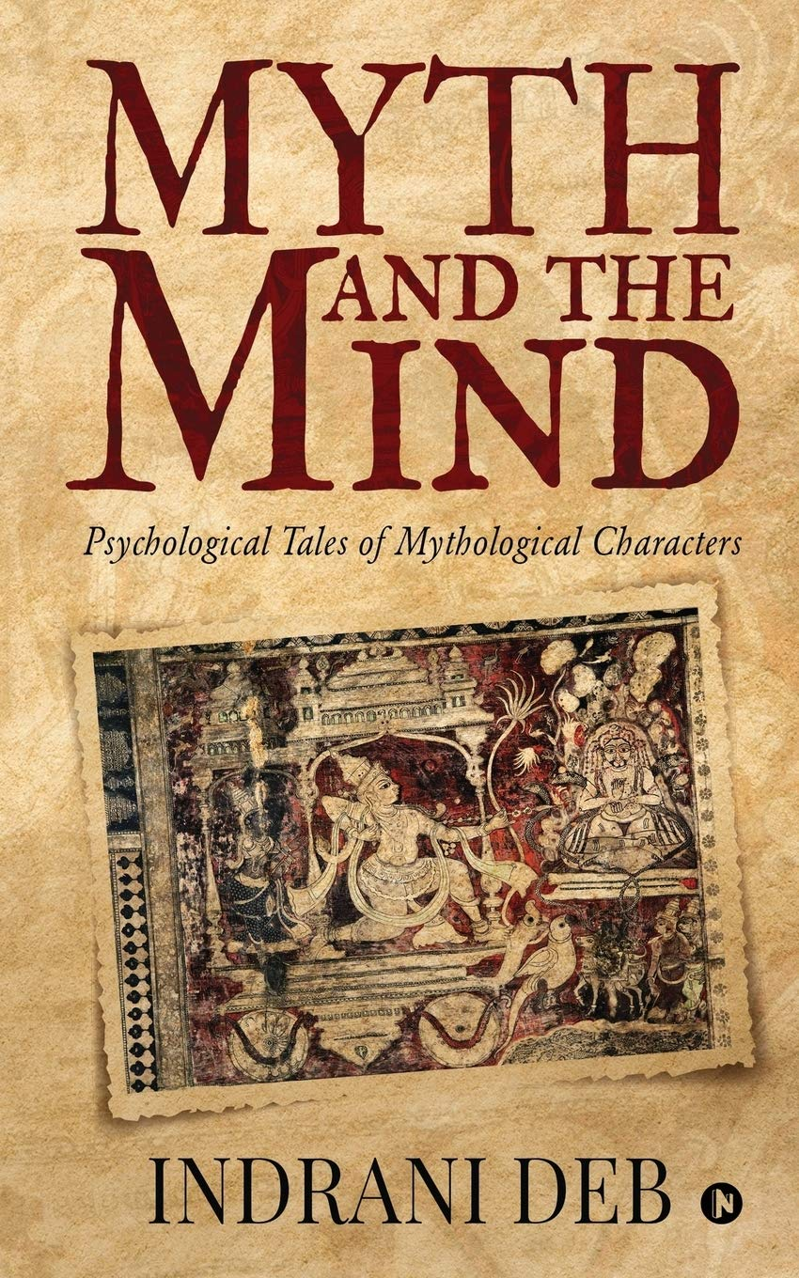
What is a myth?
myth, a symbolic narrative, usually of unknown origin and at least partly traditional, that ostensibly relates actual events and that is especially associated with religious belief.
It is distinguished from symbolic behaviour (cult, ritual) and symbolic places or objects (temples, icons).
Myths are specific accounts of gods or superhuman beings involved in extraordinary events or circumstances in a time that is unspecified but which is understood as existing apart from ordinary human experience.

Slide 3
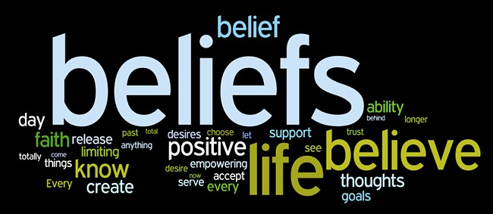
What is belief?
A belief is an attitude that something is the case, or that some proposition is true. In epistemology, philosophers use the term "belief" to refer to attitudes about the world which can be either true or false.To believe something is to take it to be true; for instance, to believe that snow is white is comparable to accepting the truth of the proposition "snow is white".
However, holding a belief does not require active introspection. For example, few carefully consider whether or not the sun will rise tomorrow, simply assuming that it will. Moreover, beliefs need not be occurrent (e.g. a person actively thinking "snow is white"), but can instead be dispositional (e.g. a person who if asked about the color of snow would assert "snow is white").

Slide 4
Difference between myths and beliefs
MYTHS | BELIEFS
Myths can be stories, seen realities, or recorded imaginations that people tell to other people so that they can make them believe in their perceptions. | Beliefs are more like personal truths regardless of what other people think we consider beliefs that we have as true, they play a part in the way we think.
Myths once formed in beliefs travel to places with the people. Myths also tell about the beliefs that persisted in the culture of societies. | Beliefs are generally formed by our experiences, inferences, and deductions or by accepting what others tell us to be true.

Slide 5
Myths about India
India is a poor country. Poverty is one part of India; it doesn’t define the entire country. Visiting DLF Emporio, Delhi’s answer to LA’s Rodeo Drive might give you a whole new perspective.
Traveling in India is dangerous But so is Compton, but that doesn’t make the entire U.S. dangerous. Yes, parts of India should be toured with caution, such as the volatile Kashmir region, but for the most part, India is just as dangerous as you make it
If you’ve seen the Taj Mahal, you’ve seen India. You couldn’t be more wrong. Yes, the Taj Mahal is beautiful, and it’s the face of India to many. It was to me. But as the world’s 7th largest country with a history that spans thousands of years, there can’t possibly be only one site worth visiting.

Slide 6
Myths about India
4. Indians don’t speak English. Sure, their accent is different, and maybe not the most pleasant-sounding, but it’s still English. English is actually one of the country’s official languages. It’s the language of the law.
5. All Indians are vegetarians. If that were true, why is chicken tikka masala one of the most famous dishes? It’s probably much easier to find a vegetarian joint in India than the Western world, but yummy dishes with chicken, fish, lamb, and the likes have found fans in many Indians.
6. Hinduism is the only religion in India. There is a majority culture of Hindus, most definitely. But there are also many Muslims, Christians, Catholics, Jews, etc. represented. Not everyone you meet will be a Hindu. In fact, even Atheism is on the rise.

Slide 7
Religious myths in India
Kali Yuga
In Hinduism, there are four distinct epochs, or yugas, and we are currently living in the fourth stage called the Kali Yuga. This era started in 3102 BC when Lord Krishna left the earth for his heavenly abode after the great Mahabharata War and thus began the degeneration of human civilization. The ancient Hindu texts of Puranas characterized Kali Yuga as being dominated by avarice, hatred, intolerance, lust and corruption. In this dark age, the average human lifespan is the shortest, lasting about 70 years whereas, in the first era of Satya Yuga, life expectancy was as long as 4,000 years.

Slide 8
2. Goddess Durga
At the same time, Indian mythology also has fierce warrior goddesses, like Durga, who is the destroyer of evil. But Durga is also known to be kind and nurturing like a mother figure when she needs to be. In the eastern states of India, like West Bengal, the Hindu festival of Dussehra is centred around a legend surrounding Durga. The celebrations commemorate the homecoming of the goddess after defeating the buffalo demon Mahishasura, who was blessed with a gift that no male could ever kill him.
3. Ram Setu Bridge
Adam’s Bridge, most commonly known as Ram Setu Bridge, connects Pamban Island near Rameshwaram in India and Mannar Island off Sri Lanka. According to the Hindu epic, Ramayana, the bridge was built by Lord Rama’s Vanara (ape men) army to help him rescue his wife, Sita, who was a captive under Ravana, the king of Lanka.

Slide 9
Myths about Indian food
Myth 1. Indian food is too spicy and hot
Fact: Indian food is not just about spices but it’s about rich flavors and aromas.
Yes, Indian food and spices have a special relationship but authentic Indian food is enriched with a variety of spices, and not every Indian dish is hot and spicy. Many Indian dishes like Saag, Aloo Gobi, or Dals are mild in flavor and tasteful.
Myth 2. Everything is curry on Indian cuisine
Fact: Indian food is more than just curry, it has a variety of dishes like sabzis, rotis, biryanis, raitas, pickles, sides, and desserts.
Most of the time, Indian food is turned down as people think it’s just about curry. But authentic Indian cuisine is beyond it. Sabzis (spicy Indian dishes) made with various fresh vegetables and spices are the main course in Indian cuisine which are enjoyed with various flatbreads.

Slide 10
Myth 3. Indian food has only one kind of bread – Roti!
Fact: There are almost 22 Indian bread types!
Indian food dishes can be best enjoyed with bread! Different parts of India have a variety of Indian bread prepared with several flours like wheat flour, corn flour, and flour made with millets. Some types of bread are baked, some are fried and some are steamed.
Myth 4. Indians enjoy only a few types of rice
Fact: There are almost 6,000 types of rice cultivated and enjoyed in India.
Well, we cannot name them all in this article but, yes, Indians love rice. There are around 6000 different varieties of rice enjoyed in India, and the most popular kind of Basmati which again has different varieties.
Myth 5. Indian food is not diet-friendly
Fact: Indian food is healthy too! It’s just about your choice.
Different Indian dishes are enjoyed on different occasions and when there are celebrations Indians don’t care about the calorie count. But the regular Indian diet people have, like daily meals, are tasty and nutritious.

Slide 11
Beliefs in India
not only do most Hindus and Jains believe the Ganges River has the power to purify – a belief with roots in Hindu scripture – but substantial minorities of Indian Christians and Muslims believe this as well. And Muslims are just as likely as Hindus (77% each) to believe in the concept of karma, which is not inherent to Islam. Meanwhile, a majority of Hindus, Muslims and Christians all believe in some form of heaven.
Although many people might consider reincarnation a core teaching in several religions native to South Asia, in no religious community does a majority express belief in reincarnation. Just 40% of Hindus, 23% of Jains and 18% of both Buddhists and Sikhs in India say they believe in reincarnation.

Slide 12
Beliefs in India
3. Different religions or traditions teach that people can escape reincarnation cycle of rebirth through various means. Achieving this liberation is often referred to as moksha, or the related concept of kaivalya. The survey asked Hindus, Sikhs and Jains if they believe in moksha and kaivalya; Buddhists were asked if they believe in nirvana, a term more often used in Buddhist teachings to refer to the state of liberation from the cycle of rebirth.
4. Most Indians say they believe in heaven (55%), though teachings about heaven vary widely across India’s religions. Some religions teach that heaven is the final destination for those who have lived a good life, others teach that it is a temporary home between rebirths, and still others teach that heaven is a state of being that people can aspire to experience during this life.
Majorities of Christians (64%), Muslims (58%) and Hindus (56%) believe in heaven. Among other religious groups, belief in heaven is less common, particularly among Buddhists (24%).

Slide 13
5. About half of Indians (49%) believe in angels or benevolent spirits. This includes roughly two-thirds of Christians (68%), about half of Muslims (53%) and Hindus (49%), and far fewer among Jains (25%), Buddhists (24%) and Sikhs (17%).
Across religious groups, Indians are generally less likely to believe in demons or evil spirits (37%).For instance, just four-in-ten Christians (41%) say they believe in demons,far lower than the share who believe in angels.
6. Indians generally (70%) say they believe in fate, the idea that events in one’s life are largely predestined. Majorities of Hindus (73%), Muslims (63%) and Sikhs (59%) say they believe in fate.Fewer Indians believe in astrology (44%), or the idea that the position of the planets and the stars can influence events in people’s lives. (Still, 83% of Indians say they fix important dates based on auspicious dates or times.

Slide 14
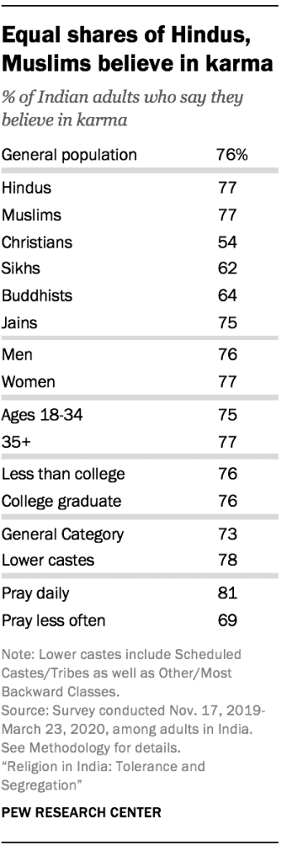
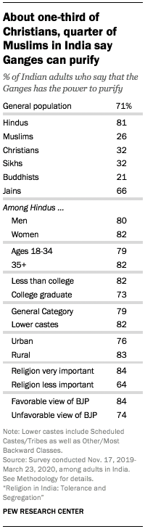
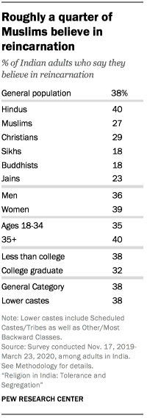

Slide 15
Thank You!!!
MADE BY-

